Slide 1

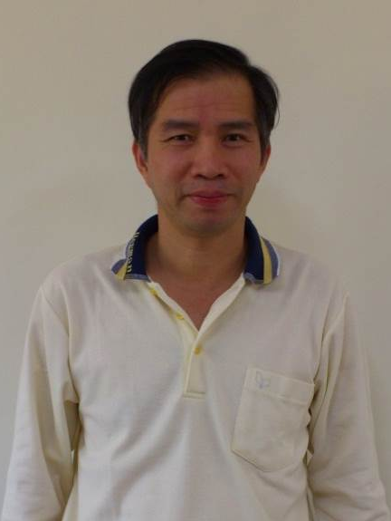
BT310 生物資源材料及能源技術實驗室
Bioresource Materials and Energy Technology Lab.
  ◎實驗室主持人 (Lab leader):
  蔡文田 博士 (Dr. Wen-Tien Tsai)
  聯絡 (Contact):
  wttsai@mail.npust.edu.tw
  08-7703202-5187/7399, 0922-804147
現職(Faculty)
國立屏東科技大學農學院生物資源博士班(生物資源研究所 ) 特聘教授
Distinguished Professor, Graduate Institute of Bioresources
學歷(Education)
- 國立台灣大學 環工博士 (1994)
- 國立台灣大學 化工碩士 (1987)
經歷(Experience)
- 嘉南藥理大學 教師 (1994-2006)
- 中鼎工程公司環工專案工程師 (1988-1991)
- 長春公司新竹廠研發課工程師 (1987)
獲獎或榮譽(Award/Honor)
- 110年中國工程師學會傑出工程教授獎
- 109年第2屆綠色化學應用及創新獎個人組(環保署)
- 108年科技部傑出研究獎(環境工程領域)
- 108年屏科大特優教學獎
研究專長與領域( Interested Research Fields/Topics)
- 生質能源技術 Biomass Energy Technology
- 碳材料 Activated carbon & Biochar
- 溫室氣體減緩與政策 Greenhouse gases mitigation & policy
- 廢棄物利用與循環化 Waste reuse and recycling
◎重要研究設備 (Important Research Apparatuses)
分光光譜儀, 真密度分析儀, 氣相層析儀, 水份測定儀, 黏度測定儀, 表面積與孔洞分析儀, 高效能液相層析儀, 界達電位&粒徑分析儀, 熱重量分析儀, 有機氯分析儀, 總有機碳分析儀, 掃描式電子顯微鏡-能量散射光譜儀,傅立葉轉換紅外線光譜, 電化學分析儀, 光學顯微儀
UV-VIS spectrometer, Gas pycnometer, Gas chromatograph, Karl Fisher moisture titrator, Viscometer, Surface area & porosimetry analyzer, High performance liquid chromatograph- Gel permeation chromatograph, Zetasizer, Thermogravimetric analyzer (TGA), Organic chlorine analyzer, Total organic carbon analyzer, Scanning Electron Microscope-Dispersive X-ray Spectroscopy (SEM-EDS), Fourier Transform infrared spectroscopy (FTIR), Electrochemical analyzer, Optical microscopy
高速離心機 , 行星式研磨機, 高週波感應加熱式裂解爐, 電熱式裂解爐, 低溫往復式震盪水槽, 高溫高壓反應器, 光催化反應器, 減壓濃縮萃取器, 冷凍乾燥器, 高溫灰化爐, 破碎機, 擠壓造粒機, 可程式烘箱, 超音波破碎機, 濺鍍機
High-speed centrifuge, Planetary mill, High-freq. induction-heating pyrolytic furnace, Electronic-heating pyrolytic furnace, Low-temp. circulating & shaking water bath, High-temperature-high pressure reactor, Photocatalytical reactor, Rotary evaporator, Freeze-dryer, Muffle furnace, Crusher, Extruded granulator, Programmed oven, Sonicator, Ion sputter

Slide 2
◎重要研究設備 (Important Research Apparatuses)
分光光譜儀, 真密度分析儀, 氣相層析儀, 水份測定儀, 黏度測定儀, 表面積與孔洞分析儀, 高效能液相層析儀, 界達電位&粒徑分析儀, 熱重量分析儀, 有機氯分析儀, 總有機碳分析儀, 掃描式電子顯微鏡-能量散射光譜儀,傅立葉轉換紅外線光譜, 電化學分析儀, 光學顯微儀
UV-VIS spectrometer, Gas pycnometer, Gas chromatograph, Karl Fisher moisture titrator, Viscometer, Surface area & porosimetry analyzer, High performance liquid chromatograph- Gel permeation chromatograph, Zetasizer, Thermogravimetric analyzer (TGA), Organic chlorine analyzer, Total organic carbon analyzer, Scanning Electron Microscope-Dispersive X-ray Spectroscopy (SEM-EDS), Fourier Transform infrared spectroscopy (FTIR), Electrochemical analyzer, Optical microscopy
高速離心機 , 行星式研磨機, 高週波感應加熱式裂解爐, 電熱式裂解爐, 低溫往復式震盪水槽, 高溫高壓反應器, 光催化反應器, 減壓濃縮萃取器, 冷凍乾燥器, 高溫灰化爐, 破碎機, 擠壓造粒機, 可程式烘箱, 超音波破碎機, 濺鍍機
High-speed centrifuge, Planetary mill, High-freq. induction-heating pyrolytic furnace, Electronic-heating pyrolytic furnace, Low-temp. circulating & shaking water bath, High-temperature-high pressure reactor, Photocatalytical reactor, Rotary evaporator, Freeze-dryer, Muffle furnace, Crusher, Extruded granulator, Programmed oven, Sonicator, Ion sputter
◎技術平台 (Technology platforms)
農林廢料熱化學性質之分析技術
Analytical techniques for the thermochemical properties of agricultural wastes.
農林廢料熱化學轉化之技術開發
Technology development on the thermochemical conversion of agricultural wastes.
多孔性碳材料表面積與孔洞特性之分析技術
Analytical techniques for the surface area and porous properties of porous carbon materials.
多孔性碳材料吸附特性之分析技術
Analytical techniques for the adsorption properties of porous carbon materials.
無機性農產廢料微奈米化之技術開發
Technology development on the micro-nano metered conversion of inorganic agrowastes.
◎目前執行計畫 (Projects in Progress)
研究計畫名稱 (Project title) | 經費來源 (Grant source) | 經費(元) (Fund, NT$)
在地殼渣生質料產製儲能用碳材料:去灰分與研磨程序對其孔洞及電化學特性之影響研究(2019/8/1~2022/7/31) | 科技部 (MOST) | 4,026,000
食品產業脫色濾渣超音波震盪分離與電漿表面改質之循環再生處理技術開發(2018/8/1~2021/7/31) | 科技部 (MOST) | 3,772,000
產學合作計畫-以小型旋轉爐水蒸氣活化法轉製非有害性油泥渣為碳質複合材料(2020/11/1~2021/10/31) | 科技部 (MOST) | 863,000
◎重要相關著作發表(通訊作者SCI/SSCI論文超過170篇)
Tsai, W.T.*, Lin, Y.Q., Tsai, C.H., Chung, M.H., Chu, M.H., Huang, H.J., Jao, Y.H., Yeh, S.I. (2020), Conversion of water caltrop husk into biochar by torrefaction. Energy, 195, 116967.
Tsai, W.T.* (2020), Status of herbicide use, regulatory management and case study of paraquat in Taiwan. Environment Development and Sustainability, 22, 2673-2683.
Tsai, W.T.*, Bai, Y.C., Lin, Y.Q., Lai, Y.C., Tsai, C.H. (2020), Porous and adsorption properties of activated carbon prepared from cocoa pod husk by chemical activation. Biomass Conversion and Biorefinery, 10, 35-434.
Tsai, W.T.* (2020), Recycling of waste electrical & electronic equipment (WEEE) and its toxics-containing management in Taiwan- A case study. Toxics, 8, 48.

